Slide 1
The Basic Languages of the Semantic Web
Semantic Technology Boot Camp
Day 2

Slide 2
Overview
Module 1
Resource Description Framework (RDF) Data Model
Module 2
RDF Schema (RDFS) |Web Ontology Language (OWL): Basics
Module 3
OWL 2: Advance Topics
Module 4
Rule Languages
Rule Interchange Format (RIF)
Semantic Web Rule Language (SWIRL)

Slide 3

RDF Data Model

Slide 4
RDF Data Model
An RDF graph is a set of RDF triples
Subject/Predicate/Object
Triples are statements (i.e. they are true or false)
The smallest graph is a single triple
 | Subject | Predicate | Object
Statement 1 | p1 | type | Person
Statement 2 | p1 | name | John Smith
Statement 3 | p1 | mbox | jsmith@acme.com

Slide 5
RDF Graph Data Model
Person
Subject and objects are “nodes” and predicates are “arcs”.
type
p1
name
mbox
John Smith
jsmith@acme.com

Slide 6
Anatomy of a URI
Uniform Resource Identifier (URI)
Fully qualified
<http://xmlns.com/foaf/0.1/Person>
Namespace
http://xmlns.com/foaf/0.1/
should end with “#” or “/”
Local name
Person
qname
foaf:Person
@prefix foaf: <http://xmlns.com/foaf/0.1/>

Slide 7
Anatomy of a URI
@prefix foaf: <http://xmlns.com/foaf/0.1/>
@prefix ex: <http://www.example.com/example#>
foaf:Person
“Cool URIs don’t change”
– Tim Berners-Lee
rdf:type
ex:p1
foaf:name
foaf:mbox
“John Smith”
<mailto jsmith@acme.com>
Notes:
“Cool URIs don’t change” – Tim Berners-Lee <http://www.w3.org/Provider/Style/URI.html>

Slide 8
Identifier Schemas
Internationalized Resource Identifier (IRI)
Uniform Resource Identifier (URI)
Universal Resource Locator (URL)
Uniform Resource Name (URN)

Slide 9
Literals
Literals are used to identify values such as numbers and dates by means of a lexical representation.
Examples:
“John Smith”^^xsd:string
“37”xsd:integer
“2011-09-22”^^xsd:date

Slide 10
Literals
Literals may be plain or typed:
A plain literal is a string combined with an optional language tag
A typed literal is a string combined with a datatype URI
A literal may be the object of an RDF statement, but not the subject or the predicate.
Literals are “dead-ends”

Slide 11
Turtle (syntax)
foaf:Person
ex:p1
rdf:type foaf:Person ;
foaf:mbox <mailto:jsmith@acme.com> ;
foaf:name "JohnSmith"^^xsd:string .
rdf:type
ex:p1
foaf:name
foaf:mbox
“John Smith”^^xsd:string
<mailto:jsmith@acme.com>
Notes:
“Cool URIs don’t change” – Tim Berners-Lee <http://www.w3.org/Provider/Style/URI.html>

Slide 12
Sample RDF Data
The RDF URI reference for this document
# baseURI: http://www.example.com/example/data
@prefix dc: <http://purl.org/dc/elements/1.1/> .
@prefix ex: <http://www.example.com/example#> .
@prefix foaf: <http://xmlns.com/foaf/0.1/> .
@prefix rdf: <http://www.w3.org/1999/02/22-rdf-syntax-ns#> .
@prefix xsd: <http://www.w3.org/2001/XMLSchema#> .
<http://www.example.com/example/data>
dc:title "Example Data Set" ;
dc:creator "Lowell Vizenor".
ex:p1
rdf:type foaf:Person ;
foaf:mbox <mailto:jsmith@acme.com> ;
foaf:name "JohnSmith"^^xsd:string .
Namespace declarations
Metadata statements
Data

Slide 13
Blank Node (or bnode)
A node that is not a URI or Literal
Corresponds to an existential quantifier

Slide 14
Blank Nodes
Use to create structured property values
ex:alion
ex:address
“1750 Tysons Blvd., Ste 1300,
McLean, VA 22102”

Slide 15
Blank Node Example
ex:Address
ex:alion
“1750 Tysons Blvd., Ste 1300”
rdf:type
ex:address
ex:street
ex:city
:McLean
_:b1
ex:alion
ex:address [
rdf:type ex:Address ;
ex:street “1750 Tysons Blvd., Ste 1300” ;
ex:city ex:McLean ;
ex:state ex:Virginia ;
ex:zipcode
] .
ex:state
ex:zipcode
:Virginia
“22102”

Slide 16
RDF Reification
RDF Reification is a way to describe other RDF statements using RDF
Provenance – record information about when statements were made, who made them, or other similar information
Issues with Reification
Triple bloat
No connection between asserted triples and RDF Statements

Slide 17
RDF Statement (Example)
rdf:Statement
:LowellVizenor
rdf:type
rdf:subject
rdf:predicate
foaf:knows
_:b2
rdf:object
_:b2
rdf:type rdf:Statement ;
rdf:subject :LowellVizenor ;
rdf:predicate foaf:knows ;
rdf:object :BarrySmith ;
:assertedBy :LowellVizenor .
:BarrySmith
:assertedBy
:LowellVizenor

Slide 18
Merging Graphs
foaf:Person
rdf:type
ex:p1
foaf:Person
rdf:type
foaf:age
foaf:gender
ex:p1
“45”
foaf:name
foaf:mbox
“male”
“John Smith”
<mailto:jsmith@acme.com>

Slide 19
Merging Graphs
foaf:Person
rdf:type
ex:p1
foaf:name
“John Smith”
foaf:age
foaf:mbox
foaf:gender
“45”
<mailto:jsmith@acme.com>
“male”

Slide 20

Linked Data Principles
Use URIs as names for things
Use HTTP URIs so that people can look up those names.
When someone looks up a URI, provide useful information, using the standards (RDF*, SPARQL)
Include links to other URIs. so that they can discover more things.
Tim Berners-Lee
http://www.w3.org/DesignIssues/LinkedData.html

Slide 21
RDF Schema (RDFS) Web Ontology Language (OWL)
Basics
Day 2

Slide 22
Schema as Ontology
A model that is used to explicitly determine the meaning of data
Contrast with XML Schema or database schema
Schema defined in the same language as the data—both are expressed in RDF triples
RDF Schema
lightweight ontology language
OWL 2
heavyweight ontology language
More expressive than RDFS in most respects, but not in all respects.

Slide 23
Description Logic
OWL2 is based on the description logic
Tbox (terminological box)
TBox contains sentences describing concept hierarchies (i.e., relations between concepts
Example: Every employee is a person
Abox (assertional box)
ABox contains ground sentences stating where in the hierarchy individuals
Example: John Smith is an employee

Slide 24
Open World Assumption (OWA)
The view that we should not draw conclusions based on the assumption that the information available currently is all the information available.
contrast with Closed World Assumption (CWA)
Negation as failure
Non-monotonic
OWA is truth preserving
Adding new information does not falsify a previous conclusion

Slide 25
Unique Name Assumption (UNA)
Different names always refer to different entities in the world.
OWL does not make this assumption, but
provides constructs to express whether two names denote the same or distinct entities
owl:sameAs
owl:differentFrom

Slide 26
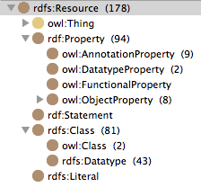
RDFS/OWL Overview
Classes
Properties
rdf:type
rdfs:subClassOf
rdfs:subPropertyOf
rdfs:domain
rdfs:range
owl:equivalentTo
owl:disjointWith
owl:intersectionOf
owl:unionOf
owl:complementOf

Slide 27
Classes and Instances
Classes are used to group individuals that have something in common.
:Mary a sl:Person
read: Mary is an instance of the class of all persons.
:Mary a sl:Person; Mary a sl:Agent
Individuals are entities that don’t have instances.

Slide 28
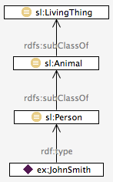
Class Hierarchy
rdfs:subClassOf used to build the hierarchy
A subclass of B definition
Every instance of A is an instance of B.
Inferred triples:
ex:JohnSmith a sl:Animal
ex:JohnSmith a sl:LivingThing

Slide 29
Class Axioms
owl:equivalentClass
Every instance of A is an instance of B and vice versa
Example:
Every equiangular triangle is a equilateral triangle, and vice versa.
owl:disjointWith
No instance of A is an instance of B
Example:
No mammal is a reptile.

Slide 30
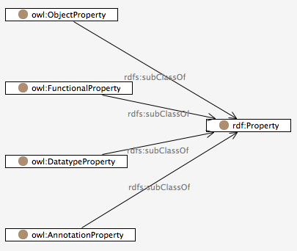
Property (aka Relations)
Object Property
has an RDF URI reference or a blank node as its object
Functional Property
has only one value as object
Datatype Property
has data value as object
Annotation Property
has information not used for reasoning

Slide 31
Examples
Object property
:JaneSmith :parentOf :JohnSmith
Functional Property
:JohnSmith :biologicalMother ex:JaneSmith
Datatype Property
:JohnSmith :dateOfBirth “1972-04-09”^^xsd:date.
Annotation Property
:JohnSmith rdfs:label “John Smith”

Slide 32
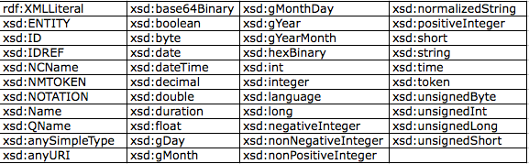
rdfs:Datatype

Slide 33
Domain and Range
rdfs:domain – determines the class membership of the subject of a triple
The domain can never be a datatype.
rdfs:range – determines the class membership of the object of a triple
The range for object properties are only classes that have RDF URI references as instances
The range for datatype properties are only classes that have data values as instances
The range for functional properties can be either.

Slide 34
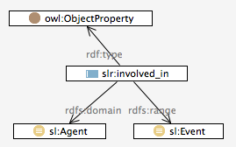
Reasoning with Domain and Ranges
domain
The subject is an instance of sl:Agent
range
The object is an instance of sl:Event

Slide 35
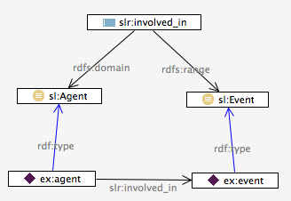
Reasoning with Domain and Ranges
Ontology
Data

Slide 36
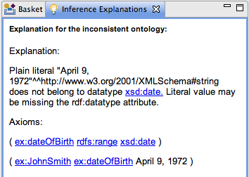
Reasoning with Domain and Ranges
ex:dateOfBirth
a owl:DatatypeProperty ;
rdfs:domain sl:Person ;
rdfs:range xsd:date .
ex:JohnSmith
a sl:Person ;
ex:dateOfBirth "April 9, 1972"^^xsd:string .

Slide 37
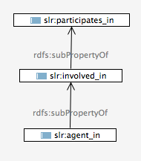
Property Hierarchy
rdfs:subPropertyOf used to build the hierarchy
R subPropertyOf Q
If R(x,y), then Q(x,y)
Asserted triple:
ex:JohnSmith slr:agentIn ex:obs1
Inferred triples:
ex:JohnSmith slr:involvedIn ex:obs1
ex:JohnSmith slr:participatesIn ex:obs1

Slide 38
Complex Classes
OWL provides language elements for logical and, or, and not.
OWL terms are borrowed from set theory: (class)intersection, union and complement.
owl:intersectionOf
Mother equivalent to (Women and Parent)
owl:unionOf
:Parent equivalent to (Mother or Father)
owl:complementOf
ChildlessPerson equivalent to (Person and(not Parent))

Slide 39
Turtle Syntax
:Mother owl:equivalentClass [
rdf:type owl:Class ;
owl:intersectionOf ( :Woman :Parent )
] .
:Parent owl:equivalentClass [
rdf:type owl:Class ;
owl:unionOf ( :Mother :Father )
] .
:ChildlessPerson owl:equivalentClass [
rdf:type owl:Class ;
owl:intersectionOf ( :Person [ owl:complementOf :Parent ] )
] .

Slide 40
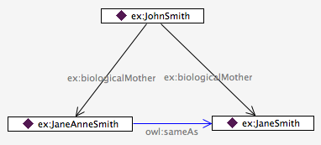
Equality and Inequality of Individuals
ex:biologicalMother
a owl:FunctionalProperty , owl:ObjectProperty ;
rdfs:domain ex:Person ;
rdfs:label "biological mother"^^xsd:string ;
rdfs:range ex:Person .

Slide 41
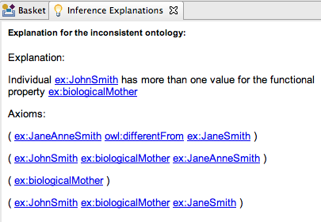
Equality and Inequality of Individuals
But what if we assert that JaneAnneSmith and JaneSmith are different?

Slide 42
Modeling with OWL (continued)
Basics
Day 2

Slide 43
Property Restrictions
A property restriction describes an anonymous class of individuals that satisfy the restriction
Two kinds of property restrictions
Value constraints
constraints on the range of the property when applied to a class description
Cardinality constraints
constraints on the number of values a property can take, in the context of this particular class description.
Uses
Defined classes
Local restrictions

Slide 44
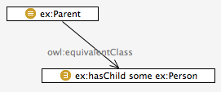
SomeValuesFrom
Example (Parent)
Every parent has at least one (some) child
ex:Parent
a owl:Class ;
owl:equivalentClass
[ a owl:Restriction ;
owl:onProperty ex:hasChild ;
owl:someValuesFrom ex:Person
] .

Slide 45
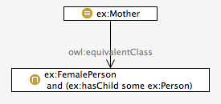
SomeValuesFrom
Example (Mother)
Every mother is a female who has at least one (some) child
ex:Mother
a owl:Class ;
owl:equivalentClass
[ a owl:Class ;
owl:intersectionOf (ex:FemalePerson [ a owl:Restriction ;
owl:onProperty ex:hasChild ;
owl:someValuesFrom ex:Person
])
] .

Slide 46
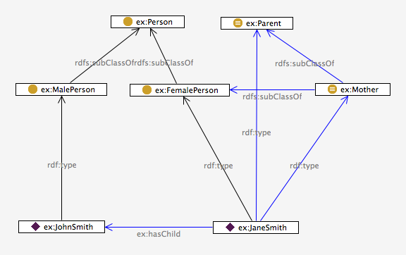
Some Inferences

Slide 47
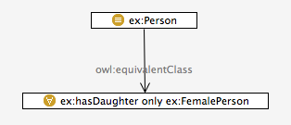
AllValuesFrom
Another property restriction, called universal quantification is used to describe a class of individuals for which all related individuals must be instances of a given class.

Slide 48
AllValuesFrom
Local Restriction on property
Domain and Range global restriction
can be too broad
FORALL ?x ?y
IF
(Person ?x) AND (hasDaughter ?x ?y)
THEN
(FemalePerson ?y)

Slide 49
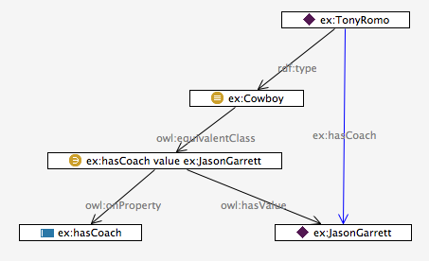
HasValue

Slide 50
Cardinality Restrictions
maxCardinality
The class of individuals that have at most two female children
hasDaughter max 2 femalePerson
minCardinality
The class of individuals that have at most two female children
hasDaughter min 2 femalePerson
exactCardinality
The class of individuals that have exactly two female children
hasDaughter exactly 2 femalePerson

Slide 51
Property Characteristics
Inverse property
?x hasParent ?y => ?y hasChild ?x
Symmetric property
?x hasSpouse ?y => ?y hasSpouse ?x
Asymmetric property
?x hasChild ?y => not (?y hasChild ?x)
Disjoint property
?x hasParent ?y => not (?x hasSpouse ?y)
Reflexive property
?x hasRelative ?x
Irreflexive property
not (?x hasParent ?x)

Slide 52
Property Characteristics
Functional property
?x biologicalMother ?y
?x biologicalMother ?z
?y sameAs ?z
Inverse Functional property
?x socialSecurityNumber ?y
?z socialSecurityNumber ?y
?z sameAs ?x
Transitive property
?x part of ?y
?y part of ?z
?x part of ?z

Slide 53
Property Chains and Keys
Property Chain (uncle of rule)
:uncleOf owl:propertyChainAxiom ( :brotherOf :parentOf ) .
Keys
:Person owl:hasKey ( :name :dateOfBirth ) .

Slide 54
Advanced Use of Datatypes
:personAge owl:equivalentClass
[ rdf:type rdfs:Datatype;
owl:onDatatype xsd:integer;
owl:withRestrictions (
[ xsd:minInclusive "0"^^xsd:integer ]
[ xsd:maxInclusive "150"^^xsd:integer ]
)
] .

Slide 55
Advanced Use of Datatypes
:personAge owl:equivalentClass
[ rdf:type rdfs:Datatype;
owl:onDatatype xsd:integer;
owl:withRestrictions (
[ xsd:minInclusive "0"^^xsd:integer ]
[ xsd:maxInclusive "150"^^xsd:integer ]
)
] .

Slide 56
Which OWL?
OWL 2 DL / Full
OWL 2 Profiles
OWL 2 EL
OWL 2 QL
OWL 2 RL

Slide 57
References
OWL 2 Web Ontology Language Primer

Slide 58
Rule Languages
Basics
Day 2

Slide 59
Example Rule Languages
Common Logic Interchange Format (CLIF)
Rule Interchange Format
Semantic Web Rule Language (SWRL)
SPARQL Inference Notation (SPIN)
F-logic (frame logic)
Description Logic
OWL 2 DL

Slide 60
Rules Interchange Format (RIF)
Purpose:
Map different rule languages to and from appropriate RIF dialects in truth-preserving ways to enable rule sets and data to be communicated between systems
Dialects of RIF
RIF Basic Logic Dialect (BLD)
Corresponds to Horn logic with various syntactic and semantic extensions
RIF Production Rule Dialect (PRD)
Captures the main aspects various production rule systems such as Jess or Jrules
RIF-Core
A subset of RIF-BLD and RIF-PRD that enables limited rule exchange between logic rule dialects and production rules
RIF Interoperates with RDF, RDFS and OWL
Uses its frame syntax to communicate with RDF/OWL

Slide 61
Uncle Rule in RIF BLD
Document (
Base(<http://example.com/family#>)
Prefix(ex <http://example.com/family#>)
Group(
Forall ?x ?y ?z (
ex:uncleOf(?z ?x) :-
And ( ex:childOf(?x ?y)
ex:brotherOf(?z ?y) )
)
)
)

Slide 62
Example
Document(
Base(<http://example.com/people#>)
Prefix(cpt <http://example.com/concepts#>)
Prefix(func <http://www.w3.org/2007/rif-builtin-function#>)
Prefix(pred <http://www.w3.org/2007/rif-builtin-predicate#>)
Prefix(xs <http://www.w3.org/2001/XMLSchema#>)
Group
(
Forall ?item ?manager ?deliverydate ?scheduledate ?diffduration ?diffdays (
cpt:reject (?warehouse ?item) :-
And (
cpt:perishable(?item)
cpt:warehouse(?warehouse)
cpt:delivered(?item ?deliverydate ?warehouse)
cpt:scheduled(?item ?scheduledate)
?diffduration = External(func:subtract-dateTimes(?deliverydate ?scheduledate))
?diffdays = External(func:days-from-duration(?diffduration))
External(pred:numeric-greater-than(?diffdays 10))
)
)
)

Slide 63
SWRL
SWRL is a proposal for a Semantic Web rules-language
Combination of OWL and Rule Markup Language
SWRL has the full expressivity of OWL DL, but not decidable

Slide 64
Uncle Rule
<ruleml:imp>
<ruleml:_rlab ruleml:href="#example1"/>
<ruleml:_body>
<swrlx:individualPropertyAtom swrlx:property="hasParent"> <ruleml:var>x1</ruleml:var>
<ruleml:var>x2</ruleml:var>
</swrlx:individualPropertyAtom> <swrlx:individualPropertyAtomswrlx:property="hasBrother">
<ruleml:var>x2</ruleml:var>
<ruleml:var>x3</ruleml:var>
</swrlx:individualPropertyAtom>
</ruleml:_body>
<ruleml:_head>
<swrlx:individualPropertyAtom swrlx:property="hasUncle"> <ruleml:var>x1</ruleml:var>
<ruleml:var>x3</ruleml:var>
</swrlx:individualPropertyAtom>
</ruleml:_head>
</ruleml:imp>

Slide 65
SWRL Built-Ins (Examples)
swrlb:lessThan
swrlb:add
swrlb:stringConcat
swrlb:addDayTimeDurations
swrlb:resolveURI

Slide 66
How to query and manipulate RDF data: An overview of SPARQL 1.1
Basics
Day 2
Draft Status – Some amount of clean up and extension to be done.

Slide 67
Overview
Querying Tables vs Graphs
Parts of a SPARQL query
SPARQL endpoints
SPARQL CRUD operations

Slide 68
Querying Tables vs Graphs

Slide 69
The Basic SQL Pattern
The “employees” Relational Table
empl_num | first_name | last_name | position | reports_to
1234 | John | Doe | Engineer 4 | Sam Smith
1235 | Susan | Arnolds | Accountant 2 | Sam Smith
1236 | Maya | Kennedy | Management 1 | Alice Sanders
1237 | Cathleen | Davis | Administrator 3 | David Newman
1238 | Wilma | Goldstein | Maintenance 2 | Alice Sanders
1239 | Alex | Smith | Admin Assistant | David Newman

Slide 70
The Basic SQL Pattern
SELECT *
FROM employees
WHERE last_name LIKE ’S%’ ;
Notes:
The query reads “Give me all fields from the employees table where the employee’s last name starts with an “S”.

Slide 71
The Basic SQL Pattern
The “employees” Relational Table
SELECT * FROM employees WHERE last_name LIKE ’S%’;
empl_num | first_name | last_name | position | reports_to
1234 | John | Doe | Engineer 4 | Sam Smith
1235 | Susan | Arnolds | Accountant 2 | Sam Smith
1236 | Maya | Kennedy | Management 1 | Alice Sanders
1237 | Cathleen | Davis | Administrator 3 | David Newman
1238 | Wilma | Goldstein | Maintenance 2 | Alice Sanders
1239 | Alex | Smith | Admin Assistant | David Newman

Slide 72
The Basic SQL Pattern
SELECT empl_num, position, reports_to
FROM employees
WHERE last_name LIKE ’S%’ ;
Notes:
The query reads “Give me only the empl_num, position and reports_to from the employees table where the employee’s last name starts with an ‘S’ ” .

Slide 73
The Basic SQL Pattern
The “employees” Relational Table
SELECT empl_num, first_name, last_name FROM employees WHERE last_name LIKE ’S%’;
empl_num | first_name | last_name | position | reports_to
1234 | John | Doe | Engineer 4 | Sam Smith
1235 | Susan | Arnolds | Accountant 2 | Sam Smith
1236 | Maya | Kennedy | Management 1 | Alice Sanders
1237 | Cathleen | Davis | Administrator 3 | David Newman
1238 | Wilma | Goldstein | Maintenance 2 | Alice Sanders
1239 | Alex | Smith | Admin Assistant | David Newman
Notes:
“Give me only the empl_num, position and reports_to from the employees table.

Slide 74
The Basic SQL Pattern
The “employees” Relational Table
SELECT empl_num, first_name, last_name FROM employees WHERE last_name LIKE ’S%’;
empl_num | first_name | last_name | position | reports_to
1234 | John | Doe | Engineer 4 | Sam Smith
1235 | Susan | Arnolds | Accountant 2 | Sam Smith
1236 | Maya | Kennedy | Management 1 | Alice Sanders
1237 | Cathleen | Davis | Administrator 3 | David Newman
1238 | Wilma | Goldstein | Maintenance 2 | Alice Sanders
1239 | Alex | Smith | Admin Assistant | David Newman
Notes:
The query reads “Give me only the empl_num, position and reports_to from the employees table where the employee’s last name starts with an ‘S’ ” .

Slide 75
The Basic SQL Pattern
The “employees” Relational Table
SELECT empl_num, first_name, last_name FROM employees WHERE last_name LIKE ’S%’;
empl_num | first_name | last_name | position | reports_to
1234 | John | Doe | Engineer 4 | Sam Smith
1235 | Susan | Arnolds | Accountant 2 | Sam Smith
1236 | Maya | Kennedy | Management 1 | Alice Sanders
1237 | Cathleen | Davis | Administrator 3 | David Newman
1238 | Wilma | Goldstein | Maintenance 2 | Alice Sanders
1239 | Alex | Smith | Admin Assistant | David Newman
Notes:
We are returned the intersection of these two conditions.

Slide 76
The Basic SQL Pattern
SELECT [ field1, field2, field3, … ]
FROM [ table ]
WHERE [ field ] LIKE ‘[ pattern ]’ ;
Notes:
We’ve been working with this basic template. Of course you can get much more sophisticate very quickly. With JOINS you would add additional tables, the where clause is optional, etc. However this is sufficient for us to make our point.

Slide 77
The Basic SQL Pattern
SELECT empl_num, position, reports_to
FROM employees
WHERE last_name LIKE ‘S%’ ;
Field names are explicit, they must exist.
The WHERE clause acts like a filter.
Notes:
The query reads “Give me only the empl_num, position and reports_to from the employees table where the employee’s last name starts with an “S”.

Slide 78
The Basic SQL Pattern
SELECT $employee $position $reportsTo
FROM http://employees
WHERE { GRAPH PATTERN }
Field names are variables, may not exist.
The WHERE clause is a matching pattern.
Notes:
The query reads “Give me only the empl_num, position and reports_to from the employees table where the employee’s last name starts with an “S”.

Slide 79
The SQL language is designed around a tabular data structure.
XPath and Xquery are likewise designed around the XML tree structure.
SPARQL is designed as a query languages for a graph structure.

Slide 80
RDF Graphs
:Alion
:Alion
?
:Manager3
:Manager3
:employs
:employs
:position
:position
:employs
:JohnDoe
:Engineer4
?
:AliceSanders
:AliceSanders
:reports_to
:reports_to
:position
:Manager2
:SamSmith

Slide 81
Querying a Graph
Consider examples here that show a basic SELECT statement and the corresponding match in the example graph

Slide 82
RDF Graphs
https://sw.alionscience.com/employees/2011
:Alion
:Manager3
:employs
:employs
:position
:position
:employs
:JohnDoe
:Engineer4
:AliceSanders
:reports_to
:reports_to
:position
:Manager2
:SamSmith
Notes:
The graph is no longer anonymous, it is named.

Slide 83
Thinking SPARQL
To think in SPARQL, think in patterns
graph patterns or shapes of data
think in graphs
a similar mindset to regular expressions thinking
The pattern language is N3
“Notation 3”
A language for expressing RDF
Learn N3 as you learn SPARQL

Slide 84
Parts of a SPARQL Query

Slide 85
Parts of a SPARQL Query
PREFIX …
SELECT …
FROM …
WHERE {
…
}

Slide 86

Simple Select
“Find all country instances and their name properties”
I’m a Class!
“Find the names of all countries”
“?” indicates a variable, something unknown.
country:Country
Objects
rdf:type
Predicates
I’m an unknown property value.
I’m a Property value!
I’m an Instance!
I’m an unknown instance.
country:name
?country
?name
“Italy”
Triple
I’m a Property!
Subject
Triple

Slide 87
Simple Select
“Find the names of all countries”
rdf:type
?country
‘?’ is the sigil in SPARQL.
‘$’ is also legal
(sigil to taste).
country:Country
SELECT ?country ?name
WHERE {
?country rdf:type country:Country .
?country country:name ?name
}
SELECT ?country ?name
WHERE {
?country rdf:type country:Country .
?country country:name ?name
}
SELECT $country $name
WHERE {
$country rdf:type country:Country .
$country country:name $name
}
country:name
?name

Slide 88
Simple Select
“Find the names of all countries”
SELECT ?country ?name
WHERE {
?country rdf:type country:Country .
?country country:name ?name
}
SELECT ?country ?name
WHERE {
?country a country:Country .
?country country:name ?name
}
SELECT ?country ?name {
?country country:name ?name
}
SELECT ?country ?name
WHERE {
?country a country:Country ;
country:name ?name
}
SELECT ?country ?name {
?country a country:Country ;
country:name ?name
}

Slide 89
Ordered Select
“Find the states and their cities”
SELECT ?state ?city
WHERE {
?cityR city:name ?city ;
uscity:state ?stateR .
?stateR state:name ?state
}

Slide 90
Ordered Select
“Find the states and their cities -sorted by state, then city name”
SELECT ?state ?city
WHERE {
?cityR city:name ?city ;
uscity:state ?stateR .
?stateR state:name ?state
} ORDER BY ?state ?city

Slide 91
Ordered Select
“Find the states and their cities -sorted by ascending state name, then by descending city name”
SELECT ?state ?city
WHERE {
?cityR city:name ?city ;
uscity:state ?stateR .
?stateR state:name ?state
} ORDER BY ASC(?state) DESC(?city)

Slide 92
Ordered Select
Compactified Expression
Found in the wild, but best to avoid –more cryptic and error prone.
SELECT ?state ?city
WHERE {
?cityR city:name ?city ;
uscity:state [ state:name ?state ]
} ORDER BY ASC(?state) DESC(?city)

Slide 93
Select with OPTIONAL
SELECT ?state ?capital ?airport
WHERE {
?stateR state:name ?state ;
state:capital ?capitalR .
?capitalR city:name ?capital
OPTIONAL {
?airportR airports:city ?capital ;
airports:airport ?airport
}
}
bridge across ontologies
Notes:
You may nest options within options.

Slide 94
Select with UNION
Comma between objects means the subject and predicate are the same.
SELECT ?state
WHERE {
{
?stateR state:borderstate usstate:AL, usstate:TN .
?stateR state:name ?state .
}
UNION
{
?stateR state:borderstate usstate:ID .
?stateR state:name ?state .
}
}

Slide 95
Select with FILTER
“Find all states that do NOT border another state”
SELECT ?state
WHERE {
?stateR state:name ?state .
OPTIONAL {
?stateR state:borderstate ?borderState .
}
FILTER ( !bound(?borderState) )
}
FILTER means “keep”
With !bound() we effectively look for the absence of a resource

Slide 96
Select with FILTER
“Find all states, and cities, where the city name begins with the letter ‘Y’ ”
SELECT ?state ?city
WHERE {
?cityR uscity:state ?stateR .
?cityR city:name ?city .
?stateR state:name ?state
FILTER( regex( xsd:string(?city), "^Y") )
}
Cast untyped literals into datatype needed by function.

Slide 97
Performance Notes
Filter early, near the top of an expression –if a condition is not met the pattern match aborts immediately.
Use OPTIONAL sparingly, they will slow down a query, sometimes drastically.
Use ASK when you do not need the results of the match –ASK will terminate when the first match if found, returns a boolean
DISTINCT and ORDERED BY may also be slow over large result sets
USE LIMIT and OFFSET with large result sets.
Notes:
Explain that ASK is identical to SELECT sans the ?variable list

Slide 98
Select with DISTINCT
DISTINCT avoids duplicate result sets
SELECT DISTINCT ?state ?city
WHERE {
?person uscity:address ?address .
?address uscity:city ?city .
?city uscity:state ?state
}
Duplicates Explained: ?person is not in the SELECT list, but many, many people will live in a ?city. Without DISTINCT one result set of ?state ?city would appear per ?person!
Without DISTINCT, one SELECT result is returned per graph pattern match.

Slide 99
SPARQL Endpoints Federated Queries

Slide 100
SPARQL CRUD Operations

Slide 101
CONSTRUCT Query
Has anyone thought it strange that we query a graph, with a graph (WHERE clause), but then process a tabular result set?
CONSTRUCT allows us to specify a graph to return.
CONSTRUCTed graphs are not inserted into the queried graph –but some tools allow the constructed graph to be asserted.
CONSTRUCT is extremely useful for transforming graphs.

Slide 102
CONSTRUCT Query
CONSTRUCT {
?countryR owl:sameAs ?nationR
}
WHERE {
?countryR a country:Country;
country:name ?country .
?nationR a capitals:Nation;
rdfs:label ?country;
}
Linkage, equating, of resources.
?country bridges two ontologies in the same graph.

Slide 103
CONSTRUCT Query
Construct resource linkages across the 3
ontology groups. The data is now linked and we can find geo coordinates for airports (in capital cities only).
CONSTRUCT {
?airportR wswm:country ?countryR ;
wswm:city ?cityR ;
wswm:state ?stateR
}
WHERE {
?airportR a airports:AirportCode ;
airports:city ?city ;
airports:country ?country .
{
# Link to International City Instances
?cityR a capitals:Capital;
rdfs:label ?city .
?countryR a capitals:Nation ;
rdfs:label ?country ;
capitals:capital ?cityR .
}
UNION
{
# Link to US City Instances
LET ( ?countryR := country:UNITED-STATES )
?airportR airports:state ?state .
?stateR state:code ?state .
?cityR city:name ?city ;
uscity:state ?stateR
}
}
Start comments anywhere with “#”
Use LET() to assign variables.

Slide 104
SPARQL 2
DELETE –use to remove unwanted triples and clean up an ontology
DELETE {
?s country:cia ?o
}
WHERE {
?s country:cia ?o
}

Slide 105
SPARQL 2
DELETE and INSERT –use together in sequence to move content:
INSERT {
?state rdfs:label ?name
}
WHERE {
?state state:name ?name
}
DELETE {
?state state:name ?name
}
WHERE {
?state state:name ?name
}

Slide 106
Advanced Topics
Named Graphs – useful when the same namespaces are used in multiple graphs:
SELECT ?state ?births
FROM NAMED <http://some.org/births.owl>
WHERE {
?stateR a state:State ;
state:name ?state ;
stats:birthRate ?births
}
Graphs names are automatic with TBC. With Gruff the names must be specified at import time into the Allegograph triplestore.
Notes:
Doesn’t significantly occur in our example data.

Slide 107
Advanced Topics
SELECT ?state ?births ?deaths
WHERE {
?stateR a state:State ;
state:name ?state ;
GRAPH <http://some.org/births.owl> {
stats:birthRate ?births
}
GRAPH <http://other.org/deaths.owl> {
stats:deathRate ?deaths
}
}

Slide 108
Advanced Topics
The graph can also be a variable
SELECT ?state ?deaths ?graph
WHERE {
?stateR a state:State ;
state:name ?state ;
GRAPH ?graph {
stats:deathRate ?deaths
}
}

Slide 109
Advanced Topics
Custom FILTER, LET and Property functions bound to Java code.
SELECT ?town ?temperature
WHERE {
?town a geo:Town;
geo:zipcode ?zipcodePlus4 .
?zipcode my:shortenZip( ?zipcodePlus4 ).
LET ( ?temperatureC := my:weather( ?zipcode ) )
FILTER( my:toFahrenheit(?temperatureC) > 100 )
}
A user defined function to shorted a 9 digit zip code to a 5 digit zip code.
User function to get current temperature at zip code.
User function to convert Celsius to Fahrenheit.

Slide 110
Tool Support
TBD: Table of popular tools and their level of SPARQL support

Slide 111
How to build ontologies in OWL

Slide 112
Modeling Events
InfectionEvent
pathogen (who)
host (what)
transmission (how)
directTransmission
indirectTransmission
occursAt (when)
locatedAt (where)

Slide 113
Modeling Roles
Roles are time sensitive
Contrast to types
Compare Person(?x) to Student(?x)
Examples
Cargo, student, target
Context
X counts as Y in context C at t1
Queries
Who was a student at George Washington University
Who is currently a student

Slide 114
Modeling Information
Information Content Entities
Designators
Names
Identifiers
Codes
Plans
Events realize Plans
Realization Rules

Slide 115
Time
OWL Time
Based on Allen's Interval Algebra
OWL Time overview
Classes
Properties
A Use Case for Scheduling
Use reasoner to determine if two meetings conflict

Slide 116
Parthood
Parthood relation
Pxy, Pyz => Pxz
Reasoning in temporal contexts
(Pxy) at t1
Solutions
Reification
Named Graphs

